Slide 1
TOCP Rack-Level Architecture
Matt St Peter

Slide 2
General OCP Characteristics
Custom Rack:
Wider aperture (21” vs 17.1”), different “U” (48mm vs 44.5mm)
Custom Power Distribution:
Three vertical 12V high-current power rails
Power GND tied to logic GND
Custom Sled and Shelf:
Three sleds across the rack width
Open sled design, very simple cooling, no EMC control
Front Cabling, No Cabling Plan:
Optical and copper cables connect from front of sleds to ToR switch
No Management Plan:
Resisting IPMI, simple concept

Slide 3
Benefits of our approach
Standard Rack and Rack-Level Components:
Can be mix-and-match, depending on application.
High Density:
Two server PCBAs per 2U sled, support for future high-capacity DRAM.
Performance:
Scaling from high-end to low-end, with equal or better performance
In-Band Management:
Simplified hardware integration, cabling
Improved sled manageability with additional features
Storage Option:
Multiple drive storage architecture
Automatic Cabling:
Rear cabling with blind-mate sled connections

Slide 4
Major Rack-Level Sections
Rack Infrastructure
Rack HW, base, panels, top
Network Connections between sleds and ToRs
Power Entry, Conversion, and Distribution
Power feed options (AC/DC, voltage, isolation)
Rear power rails with attachment to standard 19” rack
Power management
ToR Load-Balancing Switch
Mounting, power, datapath and management connections
CPU Sled and Shelf Design
Power and network blind-mate connections
Sled enclosure, mounting, alignment, and retention
PCBA mounting, HDD/SSD mounting, external I/O, EMC control
Transition board, internal cabling
Internal fans and airflow

Slide 5
TOCP System-Level

Slide 6
Rack-Level Overall View
Features:
Zone Independence:
Power
Dataplane
Management
Airflow and cooling
Selectable Zone Count
1 through 4
Field upgradable
Sleds (performance, power, features)
ToR (capacity, features)
Power (capacity)
Local Failure Domains
Use of industry standard parts
Simplicity
Low cost
Standard 44U 19” rack
Zone 1
Zone 2
Zone 3
2U Unused

Slide 7
General Rack Configuration
Front View
Side View
Front
Rear
Sled#1a
Sled#1b
16 trays
32 sleds
64 processors
Up to 40G to each sled
Sled#2a
Sled#2b
CPU sled, 2U height, 2 sleds per shelf
Sled#3a
Sled#3b
Sled#4a
Sled#4b
Sled#5a
Sled#5b
Sled#6a
Sled#6b
Sled#7a
Sled#7b
Sled#8a
Sled#8b
ToR-LB
Uplink Ports
ToR-LB
ToR-LB
Uplink Ports
ToR-LB
Sled#9a
Sled#9b
Sled#10a
Sled#10b
Sled#11a
Sled#11b
Sled#12a
Sled#12b
ToR, 2U height, 1 per zone, 8x 100Gb uplinks
Sled#13a
Sled#13b
Optical fibers, 4 pairs per 2U side, 32 sets of 4 pairs per rack
Sled#14a
Sled#14b
Sled#15a
Sled#15b
Sled#16a
Sled#16b
PSU, 4-bay, 1-2U height, 1 per zone

Slide 8
Rack-Level Detail View
Number of zones is variable
Independent power, data, management, cooling

Slide 9
TOCP Sled Configuration Options
Sled
1U CPU PCBA
1U CPU PCBA
1U sled, 4 Reduced Perf Dual-CPU PBAs per 2U, 40mm fans
1U CPU PCBA
1U CPU PCBA
Shelf
2U CPU PCBA
2U CPU PCBA
2U sled, 2 High-Perf Dual-CPU PBAs per 2U, 80mm fans
1U CPU PCBA
1U CPU PCBA
2U sled, 4 Mid-Perf Dual-CPU PBAs per 2U, 80mm fans
1U CPU PCBA
1U CPU PCBA

Slide 10
Sled Height Options
1U SLED implementation/1U Mechanical Implementation
Greater compute node density (2X) vs. 2U (assuming dual socket)
4x 40mm fans required per tray, based on tray width
Shorter heat sinks (for 1U) will limit high-end CPU SKUs
1x3.5” HDD per sled
Lower sled Network throughput requirement (1x10Gb or 1x40Gb)
Does not allow for Storage Sled
Hybrid (2x “1U” PBA, 2U mechanical enclosure)
Same compute node density, heatsinks as 1U SLED
2x 80mm fans per 2U tray
Multiple 3.5” HDD in Storage Sled
Higher throughput requirement (2x10Gb or 2x 40Gb)
Storage Sled can be one PCBA and multiple HDD

Slide 11
Rack-Level Zone 1 of 3 Detail View
Top-of-Rack can support up to 32 sleds
Up to 10 sleds per Zone (total 3 Zones)
Each Sled is made up of two Dual-Socket Servers (CPU Sled) or one on Storage Sleds
Local Zone AC-DC power conversion

Slide 12
Sled-Level Front and Side View
Right half of Shelf shown (one Sled)
Each Sled has one or two Server PCBAs in an overall 2U height
Each Compute Sled may have local boot drives. Additionally, a Storage Sled has a single Server PCBA and several rotating Drives, based on required capacity.
Two Sleds share control of the local fans. If one server fails, the other takes over.
All Sled Power and Data interfaces automatically connect when a Sled is installed in the Shelf.

Slide 13
Zone-Level Power Feed Detail
Wired DC Power Feed To ToR
Local Zone Power Rails
N+1 Redundand Modular AC-DC Conversion

Slide 14
Zone-Level Data/Management Detail
Dataplane Uplinks (Up to 16 per ToR)
Management Uplinks (2 per ToR)
Downlinks to Individual Sleds (2 per sled)

Slide 15
Tray vs. rack-level cooling
 | Tray Level | Shelf / Rack Level
Tray independence | Each trays completely independent of surrounding trays | Inter-tray dependencies for air flow & impedance fan control power budget
Management | Flat management hierarchy, no shelf/rack level layer required Simple integrated management controllers suffice | Additional layer of management required with shared controls, power & thermal budgeting BMC & ShMC required
Fans & Acoustics | Medium-size 80mm fans, much lower noise than 40mm Fans are inside sled housing | 80mm (larger size might not work) Additional shelf/rack air plenum space needed for airflow
Serviceability | Trays independently front serviceable | Rear access required, tray service impact, cost & complexity Competition with rear I/O & power rails for panel space & access
Availability | Failures localized to one tray | Fan failure impacts multiple trays
Cost & Complexity | KISS | Inter-tray dependencies, management hierarchy

Slide 16
Rack Images

Slide 17
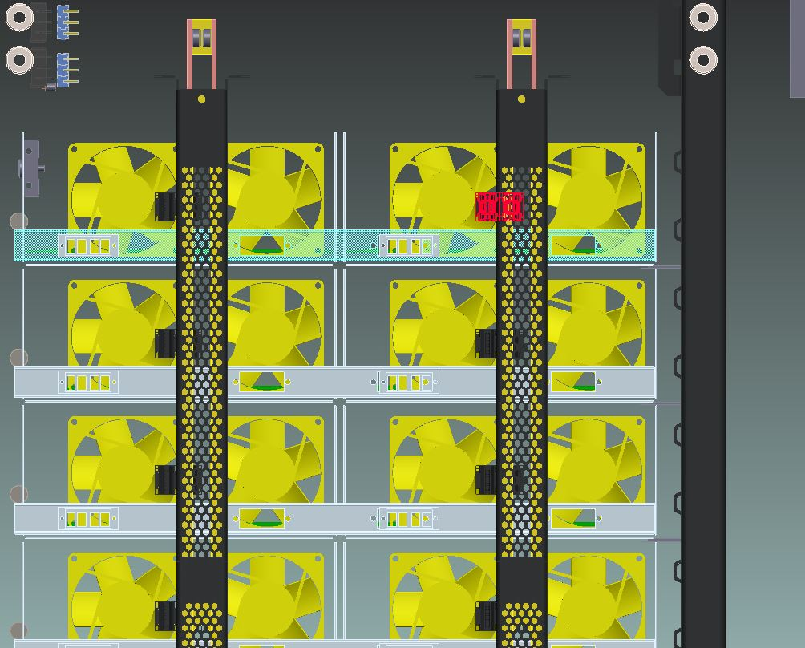
Rack-Level Rear View
Each Sled has two 80mm fans providing local airflow as needed by the local processors.
Fan capacity scales with the Sled type and performance.
Two Servers direct the fan speed based on their own needs, the fans run at the higher of the two settings.

Slide 18
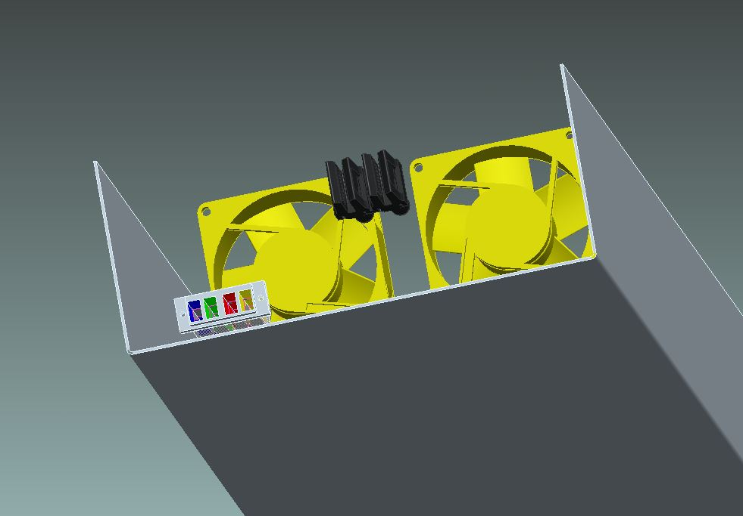
Sled Level Rear View

Slide 19
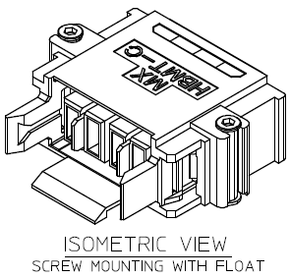
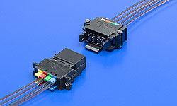
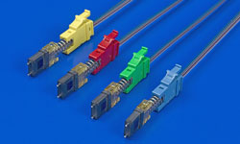
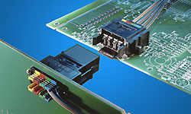
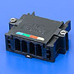
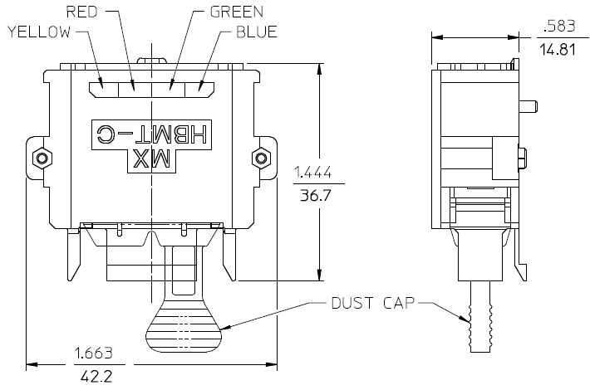
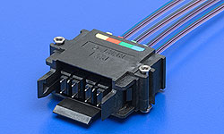
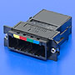
Rear Optical Interconnects
Up to 4x 2x 4 Lanes per connector with Molex HBMT
(Connect to 8 sites)
Notes:
SFP/SFP+ width = 15mm
QSFP/zQSFP+ width = 19mm

Slide 20
TOCP ToR, Gen1, 3U Physicals

Slide 21
TOCP ToR, Gen2, 2U Physicals

Slide 22
Rack-Level Power Requirements
Rack Power Feed:
DC option, -48V
AC option, two or three phase
Not clearly defined
Sled:
Direct 12V feed from vertical power rail
One 12V feed per sled (non-redundant)
Gen1 ToR:
Based on Schroff 3U 2-Slot F-B DC chassis
Cabled -48V power feed from AC/DC power shelf (may be redundant)
Gen2 ToR:
Custom design
Expected to be 2U
Direct 12V feed from two vertical power rails (redundant option)

Slide 23
Sled Components

Slide 24
CPU Sled-Level Connections

Slide 25
Storage Sled-Level Connections

Slide 26
Sled Level Top View

Slide 27
Supermicro X10DRFR Server Board
Features:
Set up for 1U enclosure height
Rear I/O Setup
Support for up to 16 DIMMS
Site for Plug-In I/O card

Slide 28
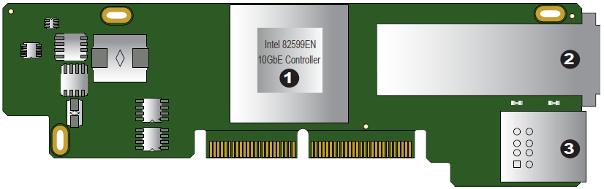
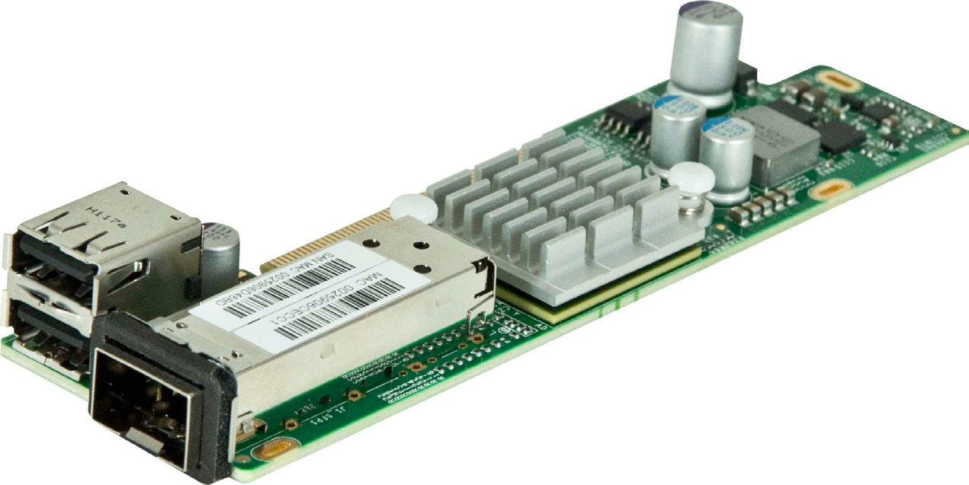
Supermicro AOC-CTG-i1S
1. Intel 82599EN 10GbE Controller
2. Single SFP+ Port
3. Dual USB 2.0 Ports

Slide 29
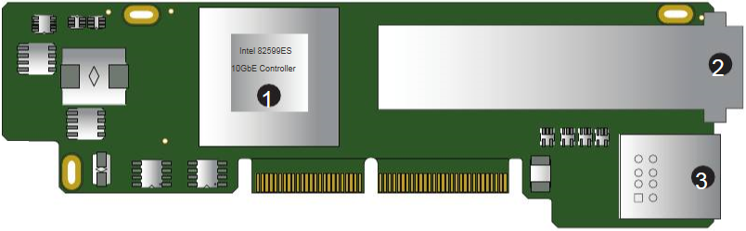
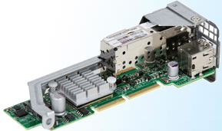
Supermicro AOC-CTG-i2S
1. Intel 82599ES 10GbE Controller
2. Dual SFP+ Port
3. Dual USB 2.0 Ports

Slide 30
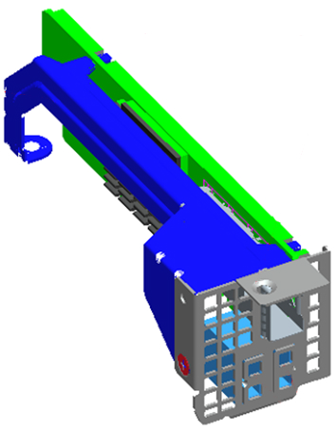
AOC-CTG-i1(2)S Support Bracket (1U)
AOC-CTG-i2S Add-In card with BKT-0061L installed

Slide 31
Work Going Forward

Slide 32
Schroff Work Areas – Summary
Sled Mechanical Design:
External dimensions, slide design, overall fit
Internal fit, eject mechanism
Storage mounting for SSD and HDD
Sled Electrical Design:
Rear interface card design
HDD interface card design
General cable fit
Power Conversion and Distribution:
AC/DC input to 12V conversion shelf for power rail
AC/DC input to -48V conversion shelf for Gen1 ToR
Internal power cabling
General Rack Mechanics:
Rack components and standards

Slide 33
Schroff Work Areas – Sled Mechanics
Overall Dimensions:
Define front and rear cable space allowance, including front optics
Width and height defined by shelf-sled mechanical interface
Define all tolerances to cover power and optical blind-mate connectors
Airflow and cooling design and test
Internal Component Fit:
Front 2.5” SSD with mounting
Exhaust fan and rear interface card positions
Main PCBA
Front Lock-Eject Lever:
Non-electrical (no eject switch)
One 12V feed per sled (non-redundant)
Storage Version HDD Mounting:
Up to five drives, install from left side
Receiver and hold-down concept
Interface card for power, LED, presence, and data

Slide 34
Schroff Work Areas – Sled Electricals
Power and Fan Interface Card:
12V high-current conducted noise filtering
DC hot-swap and soft-start interlock, fusing
Limited power control with 5V-SBY
Limited I2C support
Fan PWM and tachometer merge
Power Interlock:
Simple method, similar to ATCA hot-swap/soft-start
HDD Interface Card:
5V and 12V pass-through
Presence and LED signals
SATA signals

Slide 35
Sled Hot-Swap Support
Safe Connect/Disconnect to 12VRails:
Mechanical detect of full install with electrical shut-off
Operator BMC Interface:
Front Hot-Swap button
Hot-Swap status LED
Same concept as ATCA fan module

Slide 36
End

